Slide 1
AI

Slide 2
Artificial Intelligence
8.2.3 Problem Solving and Searching (Chapter 4)

Slide 3
Outline
Best-first search
Greedy best-first search
A* search
Heuristics

Slide 4
Drawbacks of UCS
It has no concept of where the goal state is
C≤1
C≤2
C≤1

Slide 5
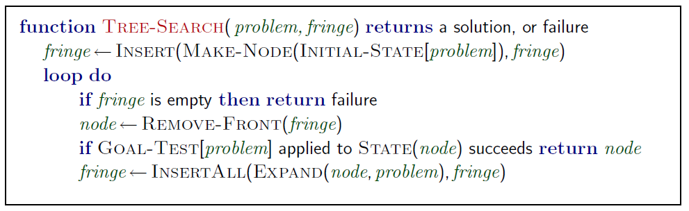
Review: Tree search
Basic idea:
offline, simulated exploration of state space by generating successors of already-explored states (a.k.a.~expanding states)
A search strategy is defined by picking the order of node expansion

Slide 6
Best-first search
Idea: use an evaluation function f(n) for each node
estimate of "desirability"
Expand most desirable unexpanded node
Implementation:
Order the nodes in fringe in decreasing order of desirability
Special cases:
Greedy best-first search
A* search

Slide 7
Greedy best-first search
Evaluation function f(n) = h(n) (heuristic)
= estimate of cost from n to goal
For example:
h_{SLD}(n) = straight-line distance from n to Bucharest
Greedy best-first search expands the node that appears to be closest to goal

Slide 8
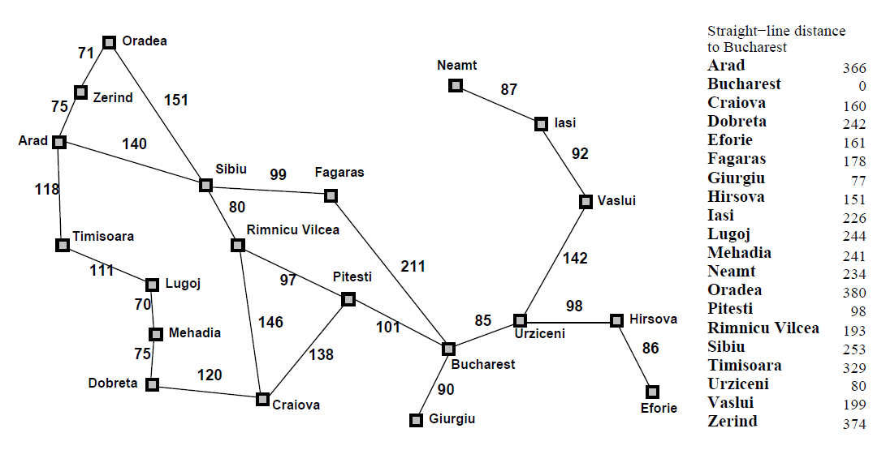
Romania with step costs in km

Slide 9

Greedy best-first search example

Slide 10
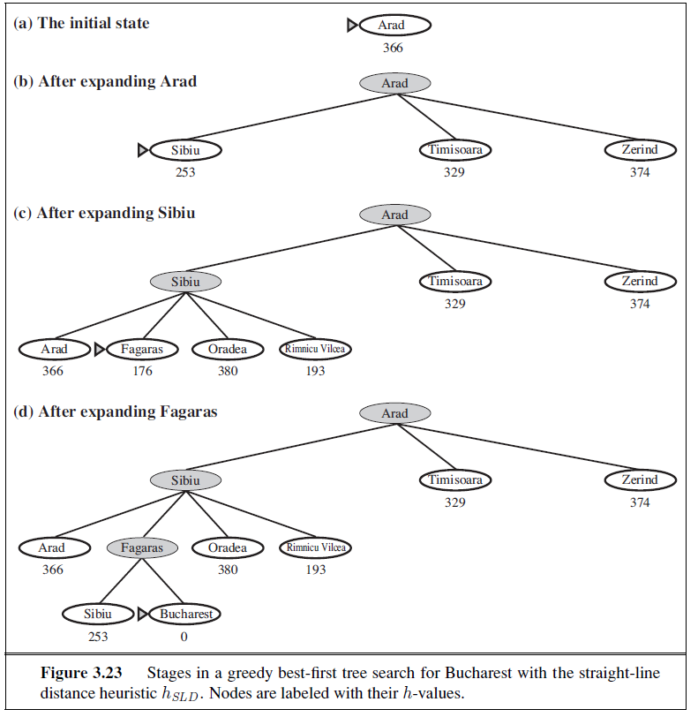
Greedy best-first search example

Slide 11
Properties of greedy best-first search
Complete?
No – can get stuck in loops, e.g., Iasi → Neamt → Iasi → Neamt →
Time?
O(b^{m}), but a good heuristic can give dramatic improvement
Space?
O(b^{m}) -- keeps all nodes in memory
Optimal?
No

Slide 12
A* search
Idea: Avoid expanding paths that are already expensive
[Hart, Nilsson, Raphael 1968]
Evaluation function f(n) = g(n) + h(n)
g(n) = cost so far to reach n
h(n) = estimated cost from n to goal
f(n) = estimated total cost of path through n to goal

Slide 13
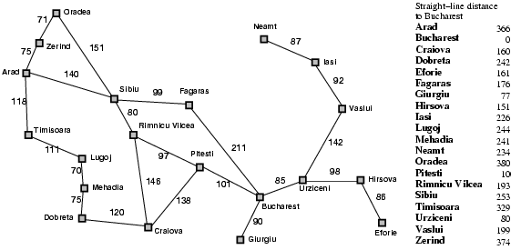
Romania with step costs in km

Slide 14
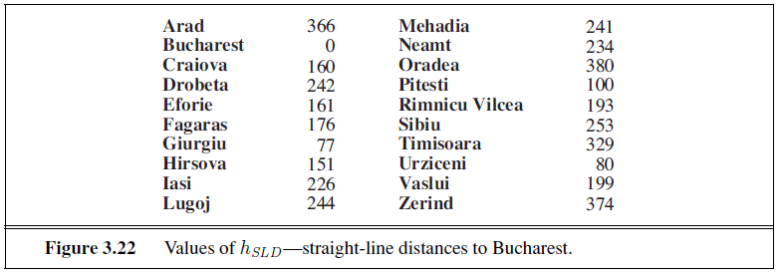
SLD Values to Bucharest

Slide 15

A* search example

Slide 16
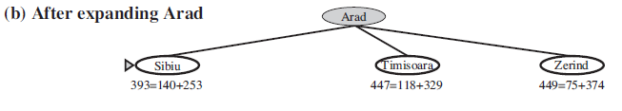
A* search example

Slide 17
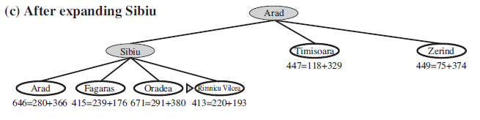
A* search example

Slide 18
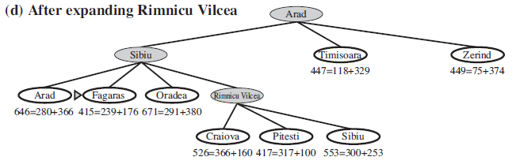
A* search example

Slide 19
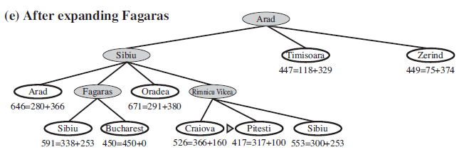
A* search example

Slide 20
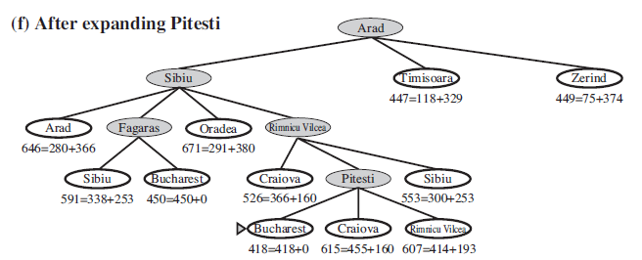
A* search example

Slide 21
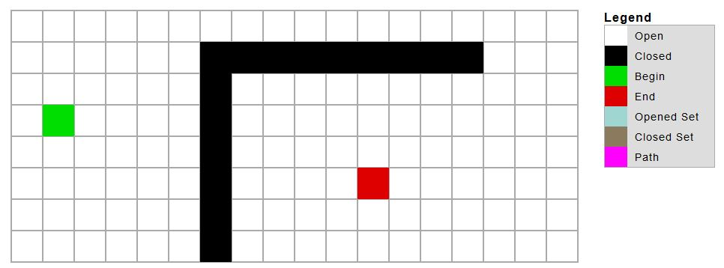
Demo
http://ashblue.github.io/javascript-pathfinding/

Slide 22
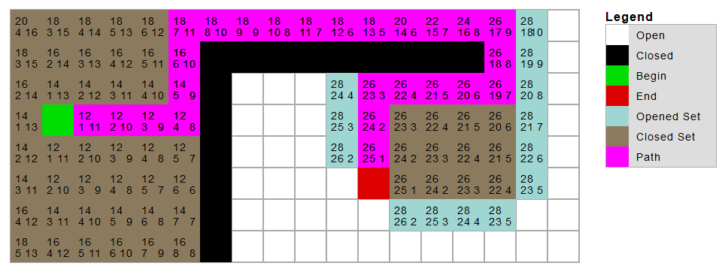
Demo
http://ashblue.github.io/javascript-pathfinding/

Slide 23
Other Demos
https://qiao.github.io/PathFinding.js/visual/
https://briangrinstead.com/blog/astar-search-algorithm-in-javascript/
http://www.policyalmanac.org/games/aStarTutorial.htm

Slide 24
Admissible heuristics
A heuristic h(n) is admissible if for every node n,
h(n) ≤ h*(n), where h*(n) is the true cost to reach the goal state from n.
An admissible heuristic never overestimates the cost to reach the goal, i.e., it is optimistic
Example: h_{SLD}(n) (never overestimates the actual road distance)
Theorem: If h(n) is admissible, A* using TREE-SEARCH is optimal

Slide 25
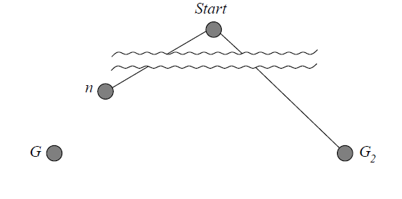
Optimality of A* (proof)
Suppose some suboptimal goal G₂ has been generated and is in the fringe. Let n be an unexpanded node in the fringe such that n is on a shortest path to an optimal goal G.
g(G₂) > g(G) since G₂ is suboptimal
f(G₂) = g(G₂) since h(G₂) = 0
f(G) = g(G) since h(G) = 0
f(G₂) > f(G) from above

Slide 26
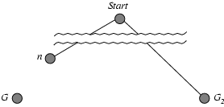
Optimality of A* (proof)
Suppose some suboptimal goal G₂ has been generated and is in the fringe. Let n be an unexpanded node in the fringe such that n is on a shortest path to an optimal goal G.
f(G₂) > f(G) from above
h(n) ≤ h*(n) since h is admissible
g(n) + h(n) ≤ g(n) + h*(n)
f(n) ≤ f(G)
Hence f(G₂) > f(n), and A* will never select G₂ for expansion

Slide 27
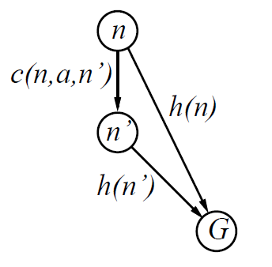
Consistent heuristics
A heuristic is consistent if, for every node n, every successor n' of n generated by any action a,
h(n) ≤ c(n,a,n') + h(n')
If h is consistent, we have
f(n') = g(n') + h(n')
= g(n) + c(n,a,n') + h(n')
≥ g(n) + h(n)
= f(n)
i.e., f(n) is non-decreasing along any path.
Theorem: If h(n) is consistent, A* using GRAPH-SEARCH is optimal

Slide 28
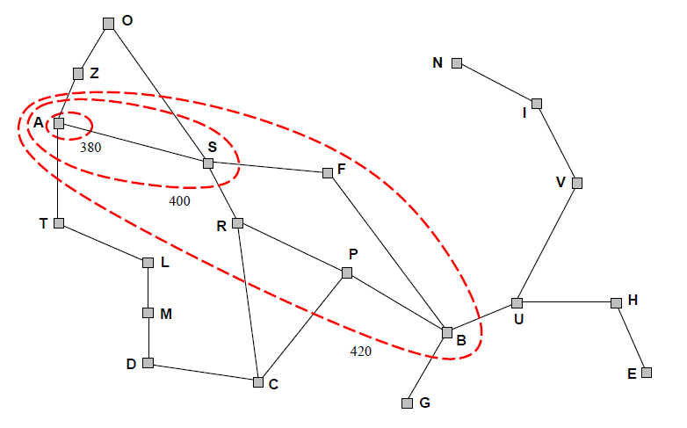
Optimality of A*
A* expands nodes in order of increasing f value
Gradually adds "f-contours" of nodes
Contour i has all nodes with f=f_{i}, where f_{i} < f_{i+1}

Slide 29
Properties of A*
Complete?
Yes (unless there are infinitely many nodes with f ≤ f(G) )
Time?
Exponential
Space?
Keeps all nodes in memory
Optimal?
Yes

Slide 30
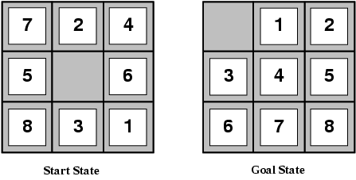
Admissible heuristics
E.g., for the 8-puzzle:
h₁(n) = number of misplaced tiles
h₂(n) = total Manhattan distance
(i.e., no. of squares from desired location of each tile)
h₁(S) = ?
h₂(S) = ?

Slide 31
Admissible heuristics
E.g., for the 8-puzzle:
h₁(n) = number of misplaced tiles
h₂(n) = total Manhattan distance
(i.e., no. of squares from desired location of each tile)
h₁(S) = ? 8
h₂(S) = ? 3+1+2+2+2+3+3+2 = 18

Slide 32
Finding a route from the East Coast to LA
https://en.wikipedia.org/wiki/File:A*_Search_Example_on_North_American_Freight_Train_Network.gif

Slide 33
Dominance
If h₂(n) ≥ h₁(n) for all n (both admissible)
then h₂ dominates h₁
h₂ is better for search
Typical search costs (average number of nodes expanded):
d=12 IDS = 364,404 nodes A*(h₁) = 227 nodes A*(h₂) = 73 nodes
d=24 IDS = too many nodes A*(h₁) = 39,135 nodes A*(h₂) = 1,641 nodes

Slide 34
Relaxed problems
A problem with fewer restrictions on the actions is called a relaxed problem
The cost of an optimal solution to a relaxed problem is an admissible heuristic for the original problem
If the rules of the 8-puzzle are relaxed so that a tile can move anywhere, then h₁(n) gives the shortest solution
If the rules are relaxed so that a tile can move to any adjacent square, then h₂(n) gives the shortest solution

Slide 35
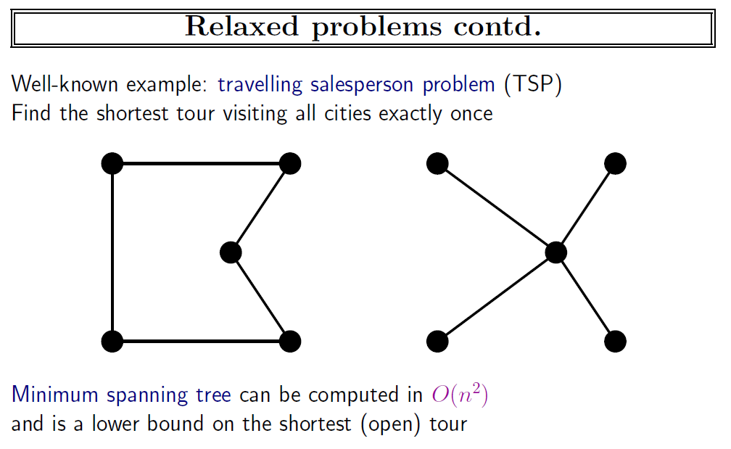

Slide 36
Summary
Heuristic functions estimate costs of shortest paths
Good heuristics can dramatically reduce search cost
Greedy best-first search expands lowest h
incomplete and not always optimal
A* search expands lowest g + h
complete and optimal
also optimally efficient (up to tie-breaks, for forward search)
Admissible heuristics can be derived from exact solution of relaxed problems

Slide 37
AI

